Slide 1
Food Distribution Program
WBSCM Account Set Up
Texas Department of Agriculture
USDA Division

Slide 2
2
Why WBSCM?
The FDP Module in TX-UNPS does not have an upgrade.
In 2010, USDA launched the Web Based Supply Chain Management System (WBSCM) specifically to support FDP.
USDA owns and regularly upgrades WBSCM, making it the best solution to serve RAs in Texas now and in the future.

Slide 3
Acknowledgement Statement
You understand and acknowledge that:
The training you are about to take does not cover the entire scope of the program; and that
You are responsible for knowing and understanding all handbooks, manuals, alerts, notices, and guidance, as well as any other forms of communication that provide further guidance, clarification, or instruction on operating the program.

Slide 4
01
Course Introduction
Course Outline and Objectives

Slide 5
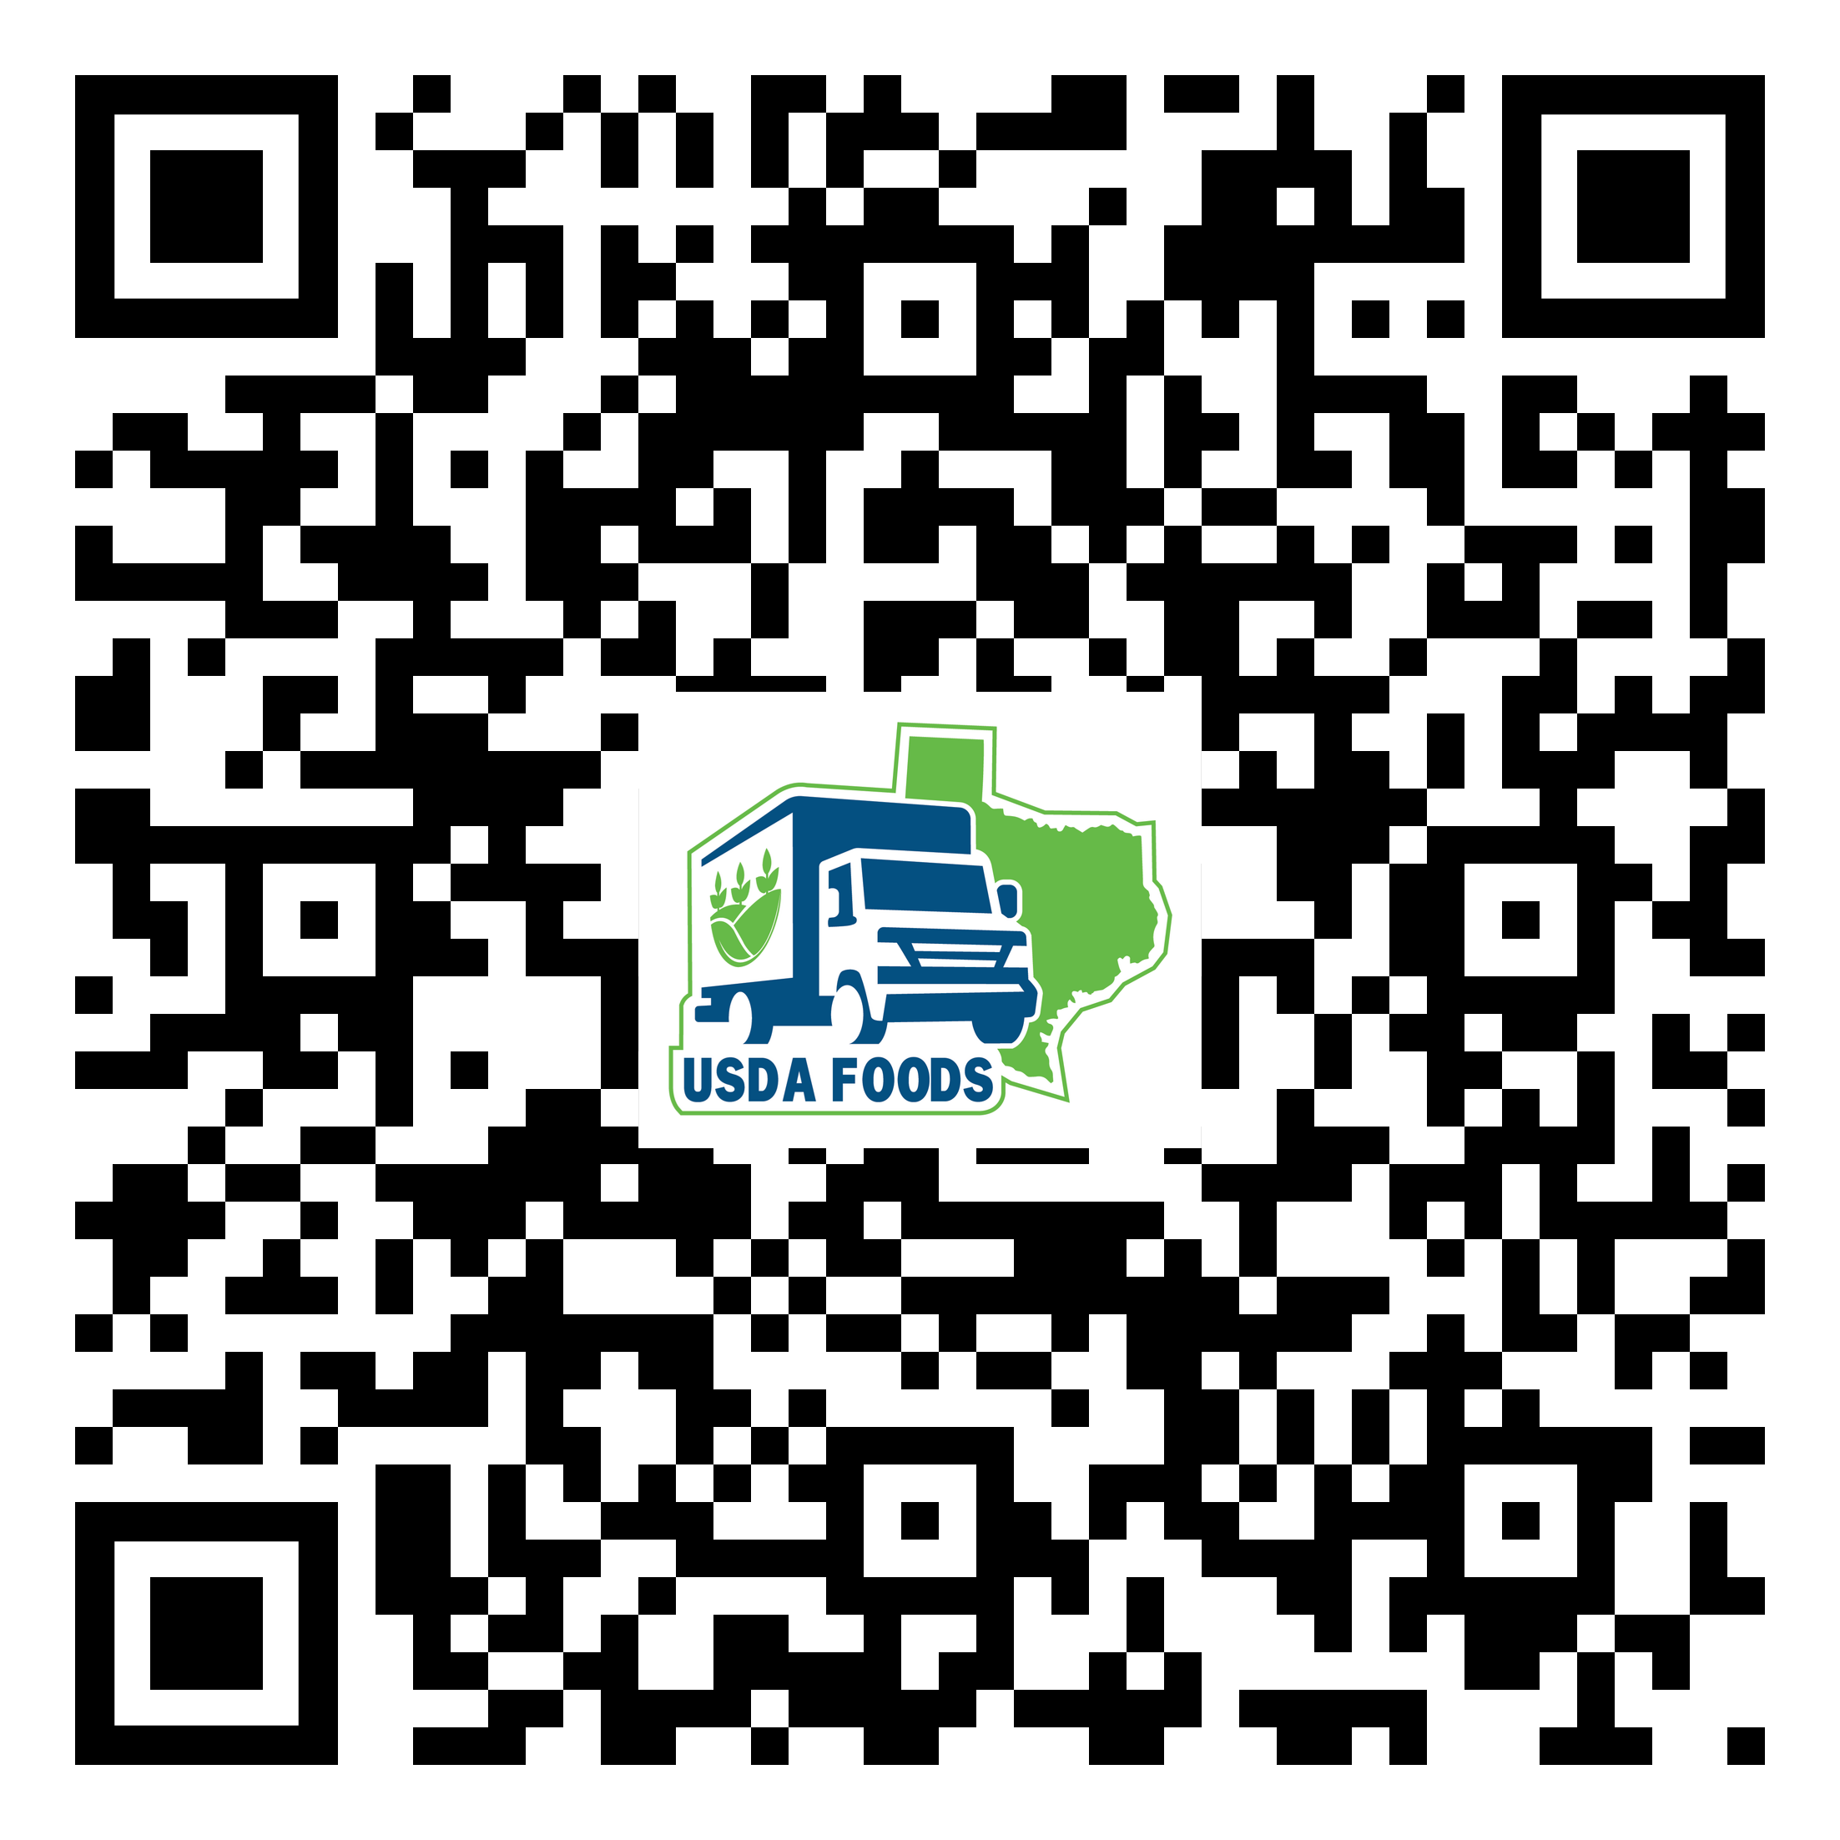
WBSCM Transition Page QR Code:
Scan QR Code to visit the Food Distribution Program WBSCM Transition website

Slide 6
Introduction
01
Course Overview and Objectives
Set Up
02
Creating WBSCM account and logging in.
Quick Access
03
Bookmarking Production Site.
WBSCM Account Set Up
Course Outline

Slide 7
Course Objectives and Outcomes
By the end of this course, participants will be able to:
Identify WBSCM specific terminology
Identify steps and understand the process for creating a WBSCM account
Create WBSCM new user account
Bookmark WBSCM Live/Production Environment

Slide 8
02
WBSCM Account
Set Up
Creating eAuth ID and Registering WBSCM Account

Slide 9
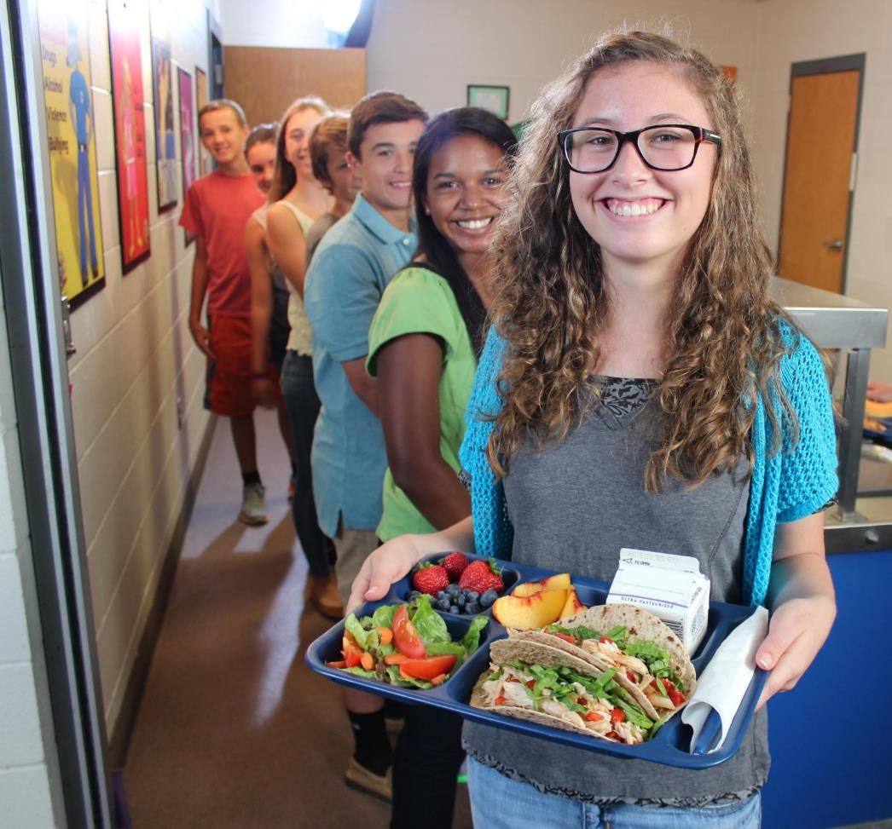
TX-UNPS to WBSCM Terms and Acronyms
TX-UNPS | Web-Based Supply Chain Management (WBSCM)
Contracting Entity (CE) | Recipient Agency (RA)
Texas Department of Agriculture (TDA) | State Distributing Agency (SDA)
Operations | Transactions
Survey | Catalog

Slide 10
WBSCM Account:
Two-Step Registration Process
WBSCM Account Registration Email from User Administrator
Step 1: Create an eAuth ID
Step 2: Register WBSCM Account
Access to WBSCM Log-in
Notes:
All Users MUST locate the Account Registration Email in order to proceed. For users with existing eAuth IDs for FFAVORS, USDA mobile FBG, etc., skip Step 1 and go to Step 2 in Registration Email from User Administrator.

Slide 11
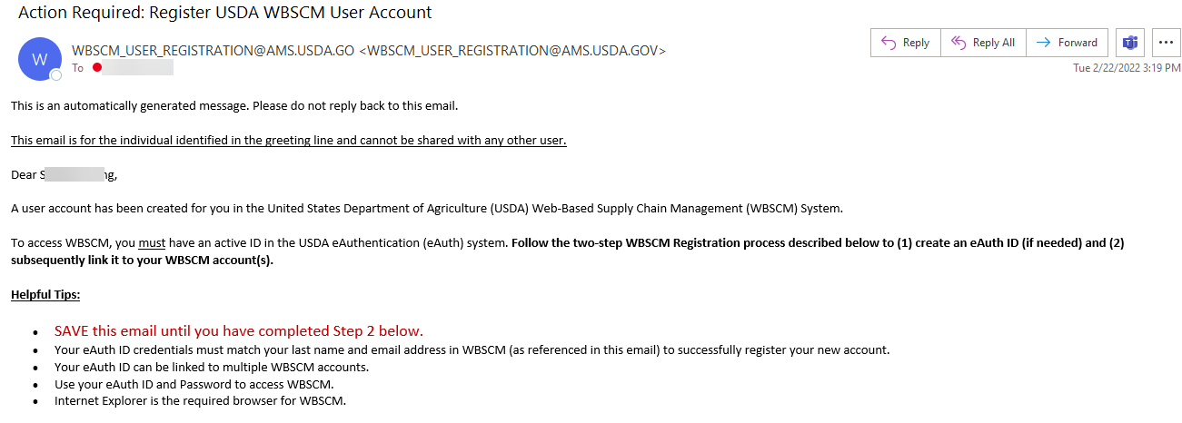
Locate the “Action Required: Register USDA WBSCM Account” Email
Search inbox / spam / deleted folders for this subject or this sender to find email
Cannot share this email
STOP! You CANNOT continue until you locate this email

Slide 12
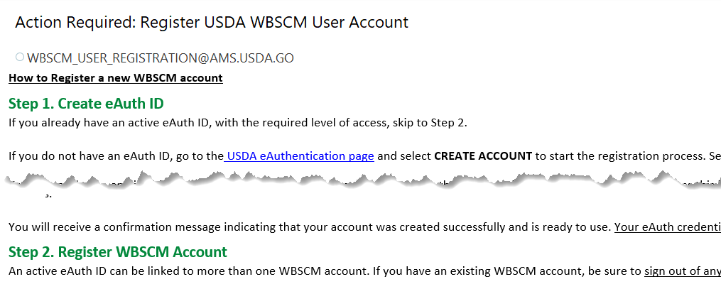
Overview: The "Action Required" Email
All Users Must Complete
Step 2
WBSCM Account Registration Email from User Administrator
Step 1: Create an eAuth ID
Step 2: Register WBSCM Account
Notes:
While users with existing eAuth accounts can skip Step 1, ALL users must complete Step 2 in the "Action Required" email.

Slide 13
Importance of The "Action Required" Email
Cannot share this link
STOP! Without this personal registration link sent to YOUR email,
you CANNOT set up a WBSCM account.
Notes:
While users with existing eAuth accounts can skip Step 1, ALL users must complete Step 2 in the "Action Required" email.

Slide 14
If you have an existing eAuth ID associated with your current business email address
(e.g. FFAVORS for DoD Fresh, USDA Mobile FBG, etc.):
Skip Step 1: Create eAuth ID
Start at Step 2 on Slide 23 (Register WBSCM Account)

Slide 15
Step 1 Open “Action Required” Email.
(This process will not work without this email!)
Notes:
For users with existing eAuth IDs for FFAVORS, USDA mobile FBG, etc., skip Step 1 and go to Step 2 in "Action Required" Email from User Administrator.

Slide 16
Step 1- Create eAuth ID
Click on link to "USDA eAuthentication" page to start Step 1.
WBSCM Account Registration Email from User Administrator
Step 1: Create an eAuth ID
Step 2: Register WBSCM Account

Slide 17
Step 1- Create eAuth Account
Click on Create Account
WBSCM Account Registration Email from User Administrator
Step 1: Create an eAuth ID
Step 2: Register WBSCM Account

Slide 18
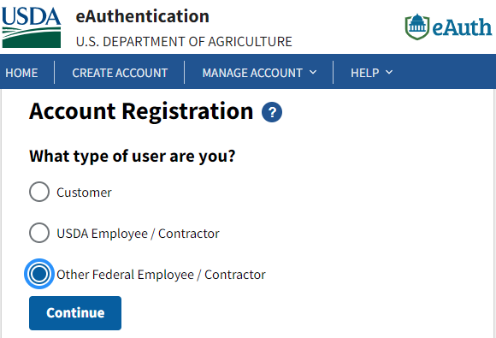
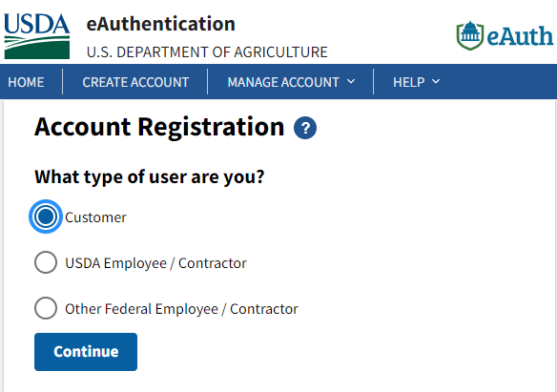
Step 1- Create eAuth Account
ESC Account Registration
RA Account Registration
Click Customer then hit Continue button.
Click Other Federal Employee then hit Continue button.
WBSCM Account Registration Email from User Administrator
Step 1: Create an eAuth ID
Step 2: Register WBSCM Account
Notes:
RA users will click on Customer, ESC staff will click on Other Federal Employee

Slide 19
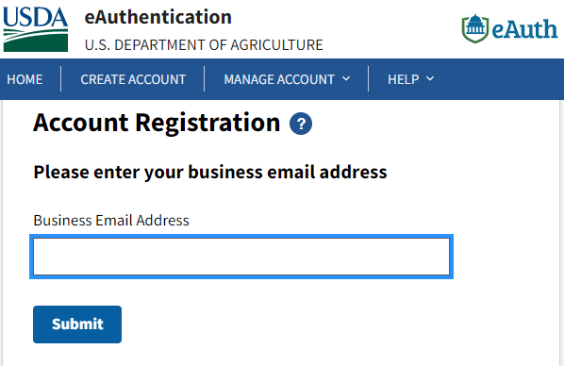
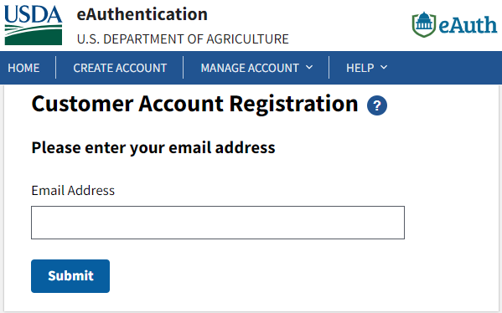
Step 1- Create eAuth Account
ESC Account Registration
RA Account Registration
Enter the email address to which the “Action Required” email was sent.
Hit Submit after entering email address
WBSCM Account Registration Email from User Administrator
Step 1: Create an eAuth ID
Step 2: Register WBSCM Account

Slide 20
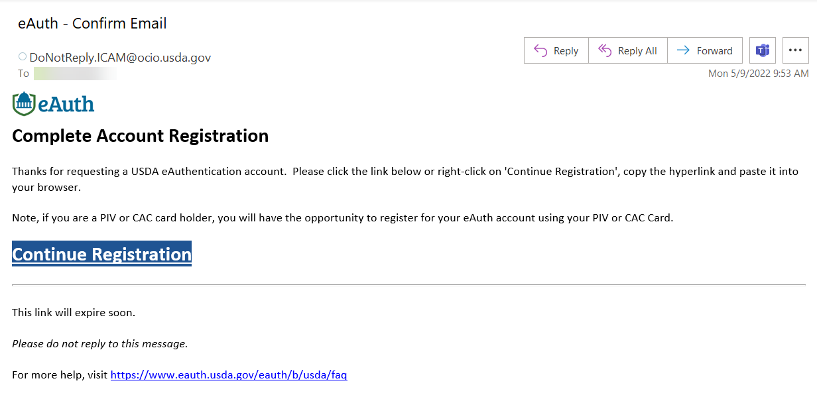
eAuth Confirmation Email
You will receive a confirmation message to continue eAuth registration
Confirmation Email subject
Click to continue to eAuth Process
Must access within 30 minutes
WBSCM Account Registration Email from User Administrator
Step 1: Create an eAuth ID
Step 2: Register WBSCM Account
Notes:
If this link expires, then users need to go back to Step 1 in original WBSCM email.

Slide 21
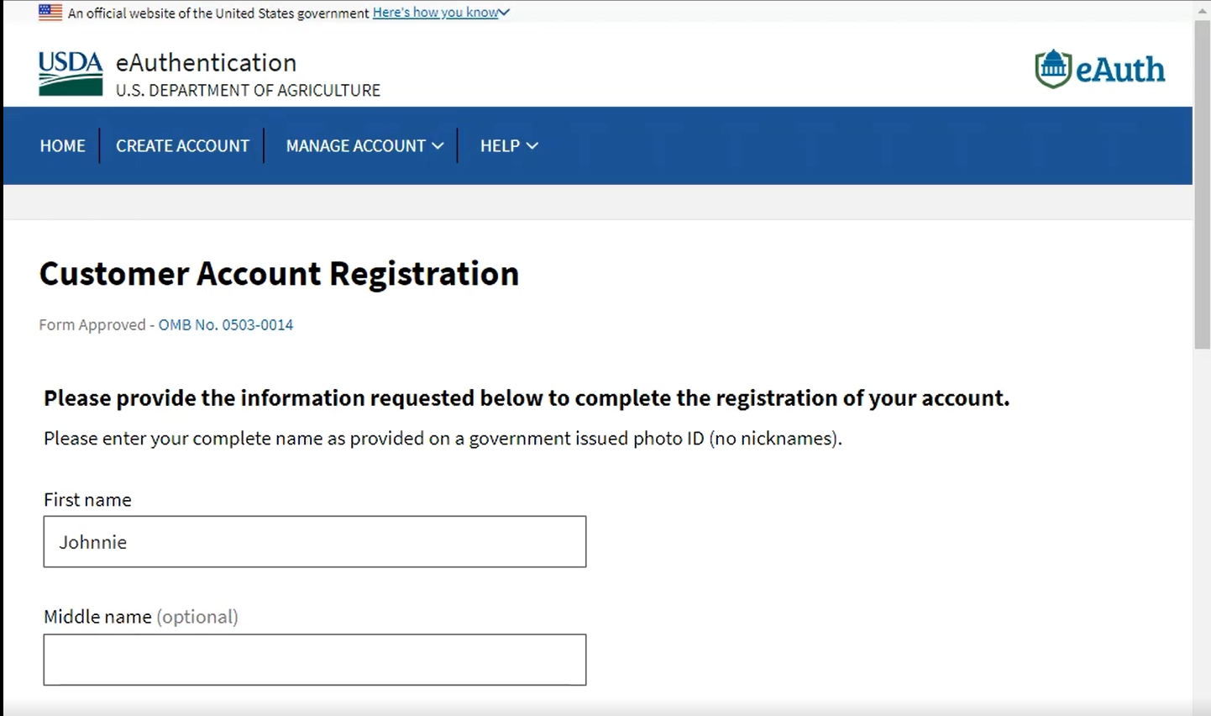
Step 1- Create eAuth Account- Customer Account Registration
Enter legal name used on government issued ID
WBSCM Account Registration Email from User Administrator
Step 1: Create an eAuth ID
Step 2: Register WBSCM Account

Slide 22
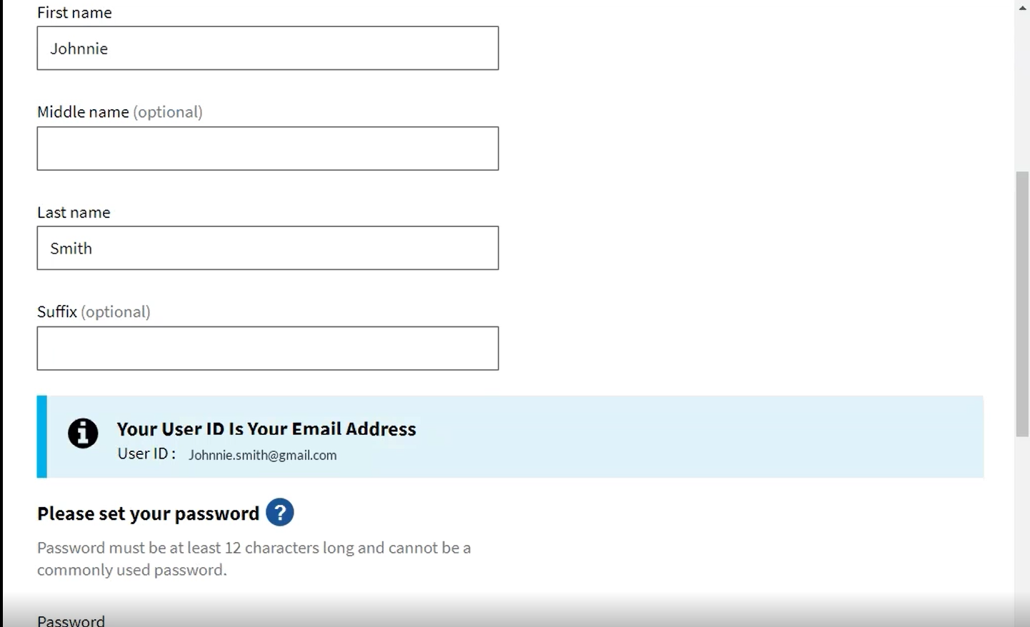
Step 1- Create eAuth Account- Customer Account Registration
Must match last name and email address in Account Registration Email
User ID is your email address
WBSCM Account Registration Email from User Administrator
Step 1: Create an eAuth ID
Step 2: Register WBSCM Account

Slide 23
Step 1- Create eAuth Account- Create Password
Create password: Must be 12 characters long
Your password must include:
12 minimum to 24 maximum characters
One number
One uppercase letter
One lowercase letter
One special character: !#$-%=+:;?~*
No spaces
Dictionary words may not be used in passwords
The previous 24 passwords may not be re-used
*Confirm password
Continue following prompts (such as security questions) to complete registration.
Enter password again to confirm
WBSCM Account Registration Email from User Administrator
Step 1: Create an eAuth ID
Step 2: Register WBSCM Account

Slide 24
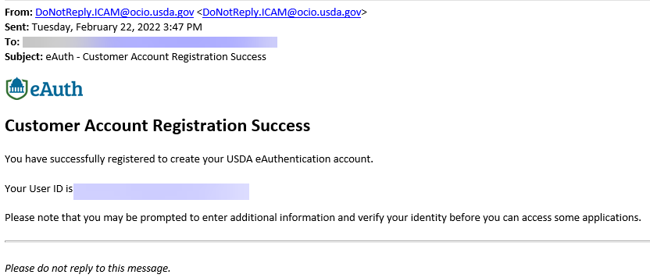
Step 1- Create eAuth Account Registration Success
eAuth Registration Success email sent as confirmation.
eAuth User ID listed in body of email
All users must continue to Step 2: Register WBSCM Account
WBSCM Account Registration Email from User Administrator
Step 1: Create an eAuth ID
Step 2: Register WBSCM Account
Notes:
All users will need to continue to Step 2: Register WBSCM Account

Slide 25
Step 2 Go to the original “Action Required” Email to complete the Registration Process.
Notes:
•Users who have existing eAuth IDs will start the WBSCM Account Set Up Process here.
•Users who have existing eAuth IDs will need to locate the Action Required: Register WBSCM User Account Email.
•May need to check spam.

Slide 26
Step 2- Register WBSCM Account
May need to scroll down Action Required email to find Step 2.
Click the long registration link to finish setting up WBSCM Account
WBSCM Account Registration Email from User Administrator
Step 1: Create an eAuth ID
Step 2: Register WBSCM Account
Notes:
Users will need to click the longer registration link.
This link is original and unique to each individual. Sharing this link with other users will result in error messages.
This link is the only method in which users can complete the account creation process for WBSCM.

Slide 27
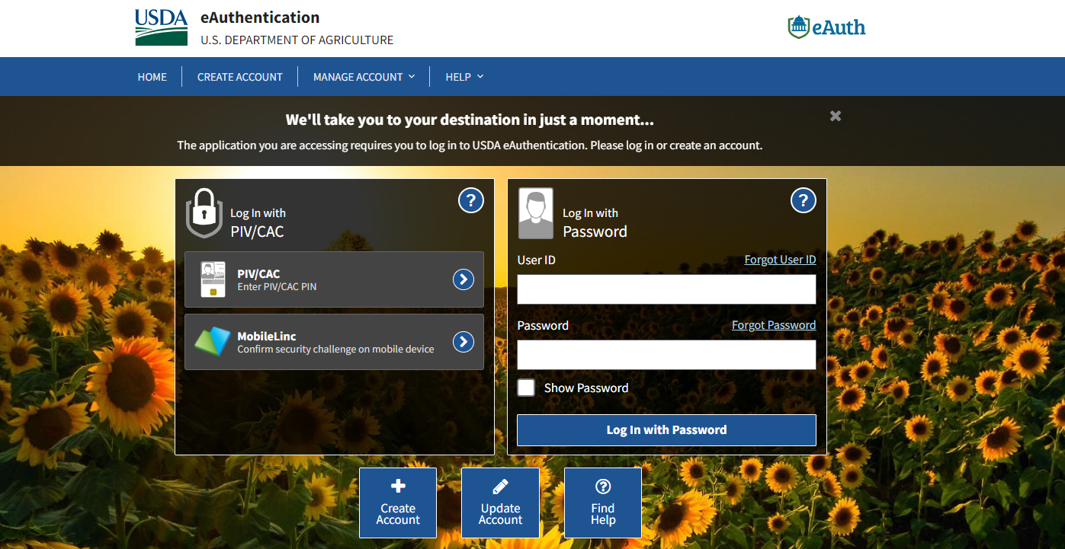
Step 2- Register WBSCM Account
eAuth User IDs may include:
Email address
Numbers (e.g. 17623)
Letters and Numbers (e.g. SM1943)
Symbols and Numbers (e.g. 17@634)
johnnie.smith@anytownisd.org
Enter eAuth User ID
yourpassword
Enter password
Hit Log In button
WBSCM Account Registration Email from User Administrator
Step 1: Create an eAuth ID
Step 2: Register WBSCM Account
Notes:
Users with existing eAuth IDs enter eAuth User ID and Password and login.
If errors occur for users with existing eAuth IDs, different credentials may have been used for the original eAuth ID. Call eAuth Help Desk for assistance.

Slide 28
Step 2- Rules of Behavior
Scroll to read all Rules of Behavior
Click Accept and hit Submit.
WBSCM Account Registration Email from User Administrator
Step 1: Create an eAuth ID
Step 2: Register WBSCM Account

Slide 29
Congrats! You Are Logged In and At The WBSCM Portal Home Screen
The WBSCM logo indicates live system.
User’s Name and Organization Name will be listed.
WBSCM Account Registration Email from User Administrator
Step 1: Create an eAuth ID
Step 2: Register WBSCM Account
Access to WBSCM Log-in
Notes:
Confirm all users got in. Provide troubleshooting assistance for those who have not successfully registered their account. Users should book mark this site while they are logged in here or use the steps in slides 28-30 for instructions.

Slide 30
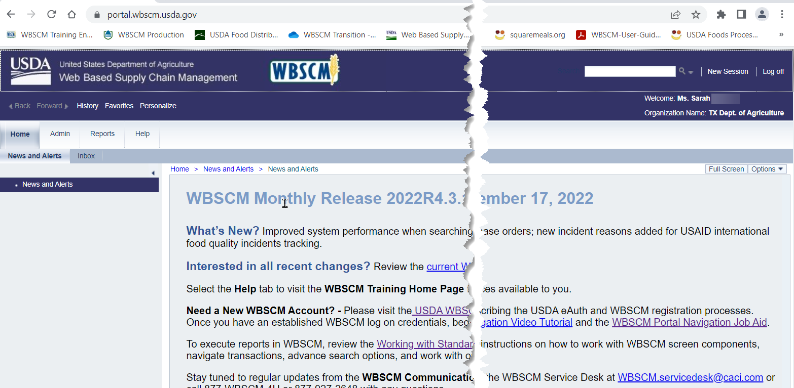
WBSCM “Live” Portal Bookmarking
Click on star in address bar to bookmark.
portal.wbscm.usda.gov

Slide 31
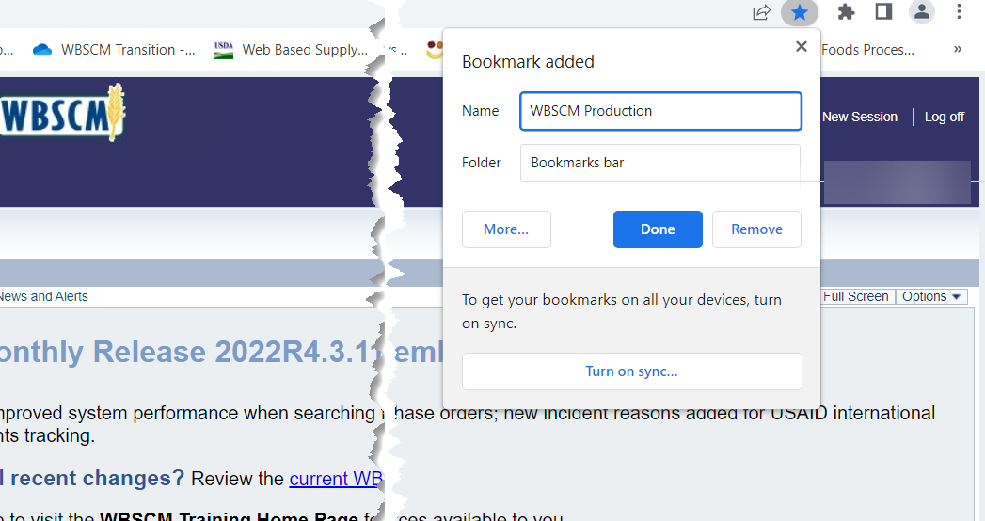
WBSCM Portal Bookmarking
Type WBSCM Production or WBSCM Live in the "Name" box to label the bookmark.
Click the done button to finish adding bookmark
Notes:
Name the bookmark to the live production environment WBSCM Production or WBSCM Live

Slide 32
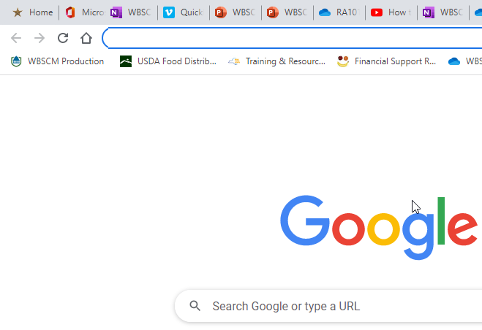
WBSCM Portal Bookmarking
Portal icon can be moved to the bookmarks bar.
Notes:
Users can drag bookmark icon to be placed in a prominent position under the web address bar.

Slide 33
WBSCM Login Issue #1
WBSCM Login Issue #2
Issue: Forgot User ID
Resolution: Click on Forgot User ID and follow prompts
Issue: Forgot password
Resolution: Click on Forgot Password and follow prompts
Click on Forgot Password
Click on Forgot User ID

Slide 34
When to Contact
eAuth Help Desk
1. eAuth system error message
**ALL OTHER ISSUES**
eAuth Help Desk will not be able to assist. Refer to the Contact List on SquareMeals
1. Go to eAuth Contact Us Link
2. Scroll down to
eAuthentication Help Desk
3. Click on the Help Desk Link.
Notes:
For trouble with eAuth system error messages, access eAuth Help Desk.

Slide 35
WBSCM Issues
Resolution
Do not see catalogs
Do not see personal data
Do not see previous requisitions.
Check banner logo to make sure you are logged in to live system.
The WBSCM logo indicates live system.
The NTRN logo indicates training environment.

Slide 36
When to Contact
WBSCM Help Desk Contact Information
1. Receive a red error message
2. A tab/option disappeared
3. WBSCM closes unexpectedly
**ALL OTHER ISSUES**
WBSCM Help Desk will not be able to assist. Refer to the Contact List on SquareMeals
Help Desk Hours: 8:00 AM to 6:00 PM Eastern Time
Help Desk Contact Information: 877-927-2648 WBSCM.servicedesk@CACI.com
Notes:
For system related issues with WBSCM, access WBSCM Help Desk.

Slide 37
Questions?

Slide 39
Contact Us
https://squaremeals.org/Programs/FDPWBSCMTransitionProject.aspx
Diana Chavarria
CN Technical Support
Diana.Chavarria@esc15.net
325.658.6571

